Slide 1


Project Presentation
Mobile LoRaWAN Gateway
Maxim Kolchinsky, Ilya Freidkin
Itzik Ashkenazi, Aviel Glam

Slide 2
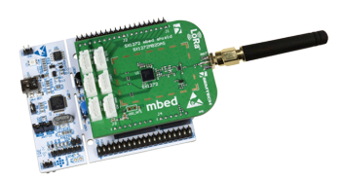
Background – Project (1)
Small sensors are widely used in IOT in recent years
Sensors are compact, effective with long battery life
Traditional data access from sensors is very limited

Slide 3
Background – Project (2)
We want to use a drone to access sensors from a distance to collect data
Plan and implement a protocol between sensors and the drone to
Minimize battery usage
Minimize drone flight time and number of flights

Slide 4
Background – LoraWAN (1)
LoRaWAN is a point-to-multipoint networking protocol
Long range (up to 15km)
Low power (up to few years of battery life)
Low Bandwidth (250bit/s to 11kbit/s)
Low cost (less than 20€ CAPEX per node)
Bidirectional communication.
Security (128bit end-to-end encrypted)

Slide 5

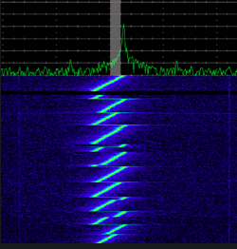
Background – LoRaWAN (2)
LoRa works by moving an RF tone around over time in a very linear way.
LoRa transmissions work by chirping

Slide 6

Background – LoRaWAN (3)
LoRaWAN has three classes
Class A – Uplink messages can be sent any time
Class B – Scheduled receive windows for downlink messages from the server
Class C – Keeping the receive windows open unless they are transmitting

Slide 7
Motivation
The GW is physically connected to the drone, the sensors are scattered across a large polygonal area and the server is offline until the drone returns and unloads the data.
We need a protocol that allows:
Long range communication
Low power usage
Synchronized for usage with multiple end nodes
LoRaWAN is the best wireless protocol solution for our task!

Slide 8
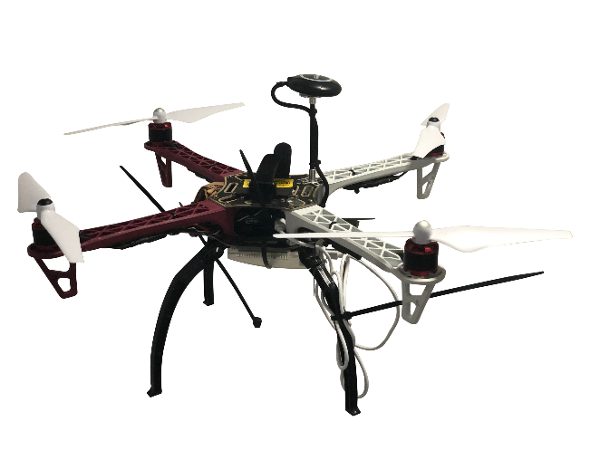
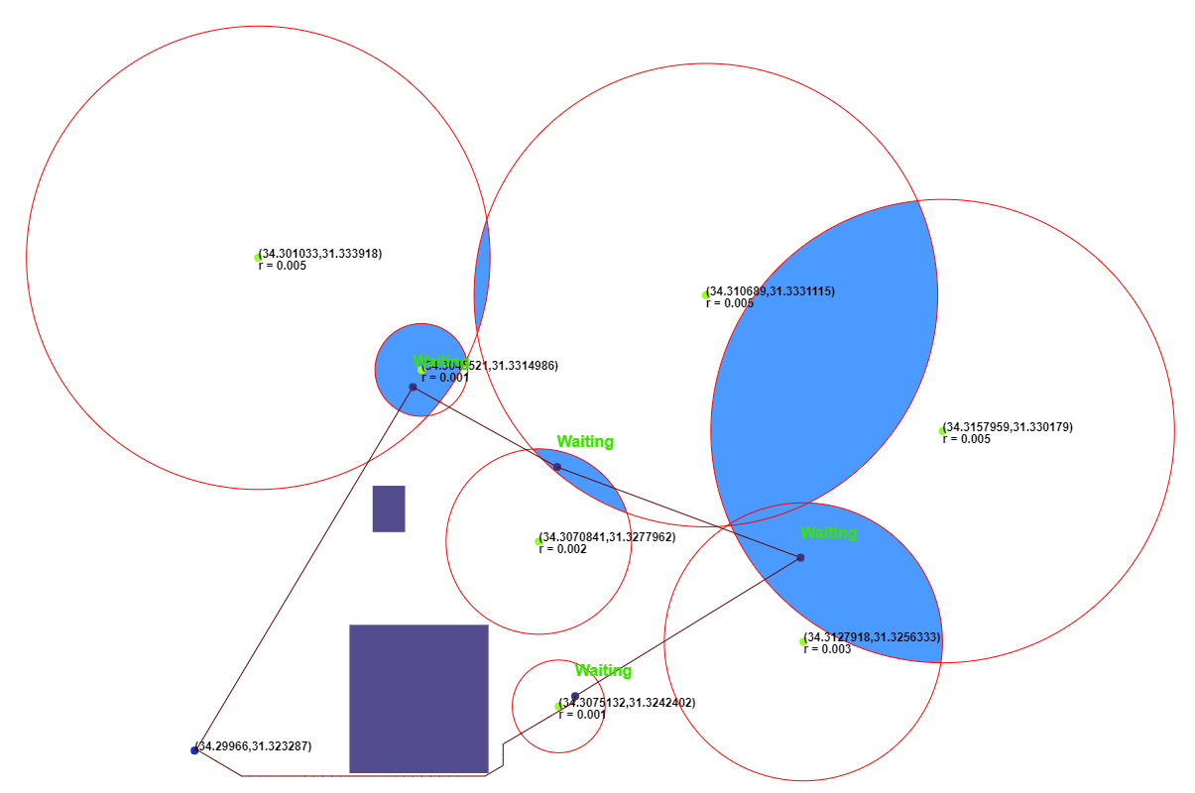
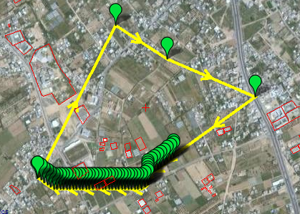
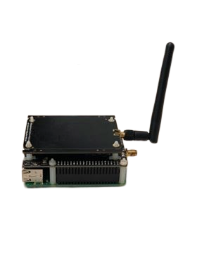

Architecture – High level
Path Planning
Mission Planner
Drone
LoRaWAN Server
LoRaWAN GW
LoRaWAN Sensors

Slide 9
Project Targets & Solution
Learn
Learn about LoRa and LoRaWAN protocols while getting practical experience in modifying said protocols for our purpose.
Modify
Allow GW to store packets received from sensors and then unload them to server via Ethernet.
Create
Create a smart path planning algorithm for the drone to collect data from multiple scattered sensors with different signal radii.
Experiment
Do live experiments of flying the drone to confirm that said algorithm works and that data from sensors has successfully been gathered.

Slide 10
Solution – Path Planning
Path Planning
Mission Planner
Drone
Path Planning
Mission Planner
LoRaWAN Server
LoRaWAN GW
LoRaWAN Sensors

Slide 11
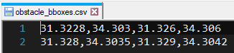
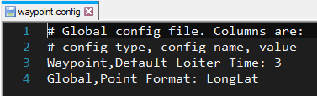
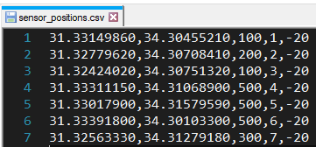
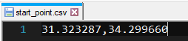
Solution – Path Planning (1)
Path planning algorithm receives an input of:
Start point
Sensor points and their metadata (signal radii, RSSI and ID)
Obstacle bboxes
External config file

Slide 12
Solution – Path Planning (2)
Using Python we generate a .waypoint file to be read and processed by mission planner
Using Python and JavaScript we generate an animated simulation of the path of the drone in 2d.

Slide 13

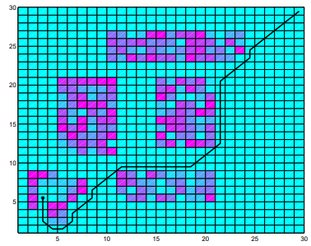


Solution – Path Planning (3) Explaining the algorithm

Slide 14
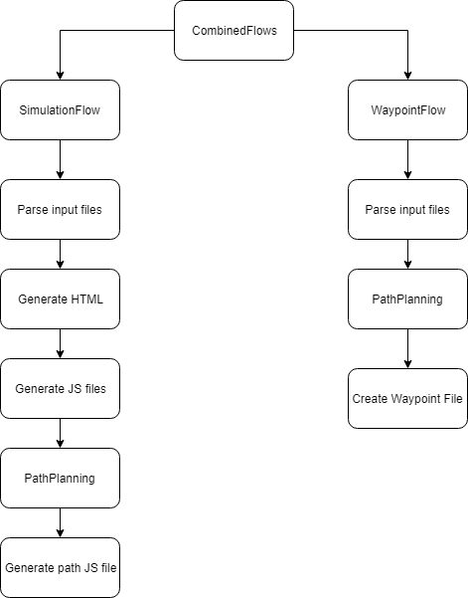
Solution – Path Planning – Algorithm Flow (1)

Slide 15
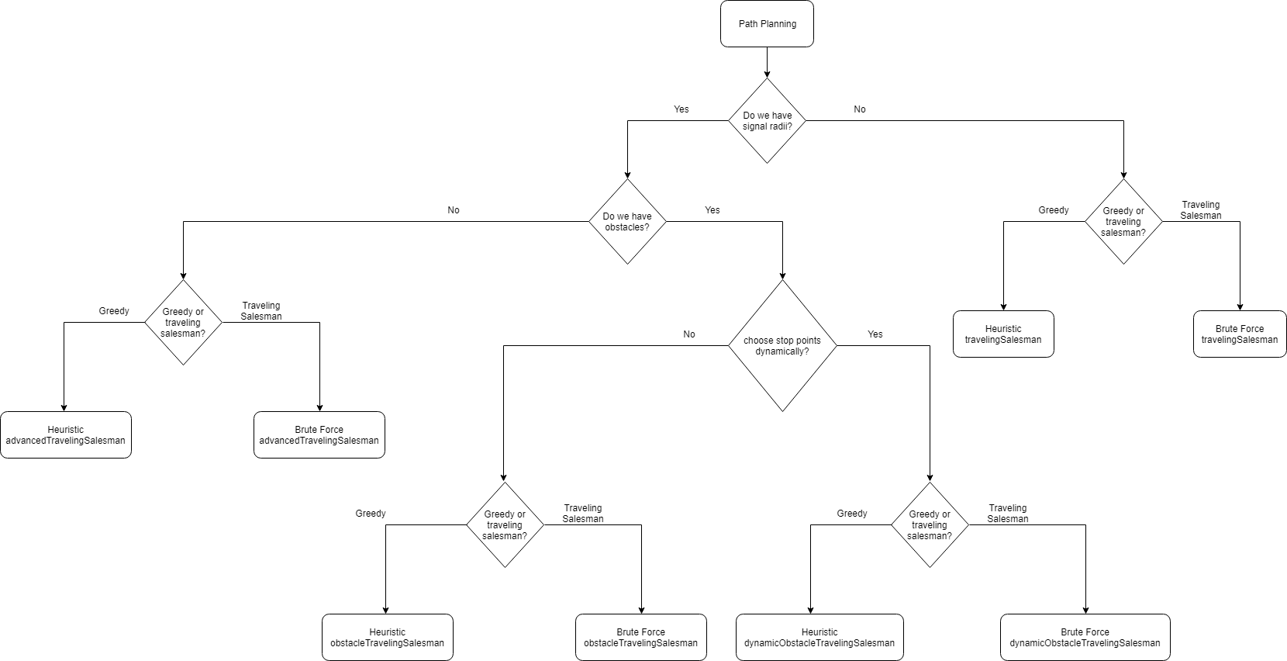
Solution – Path Planning – Algorithm Flow (2)

Slide 16
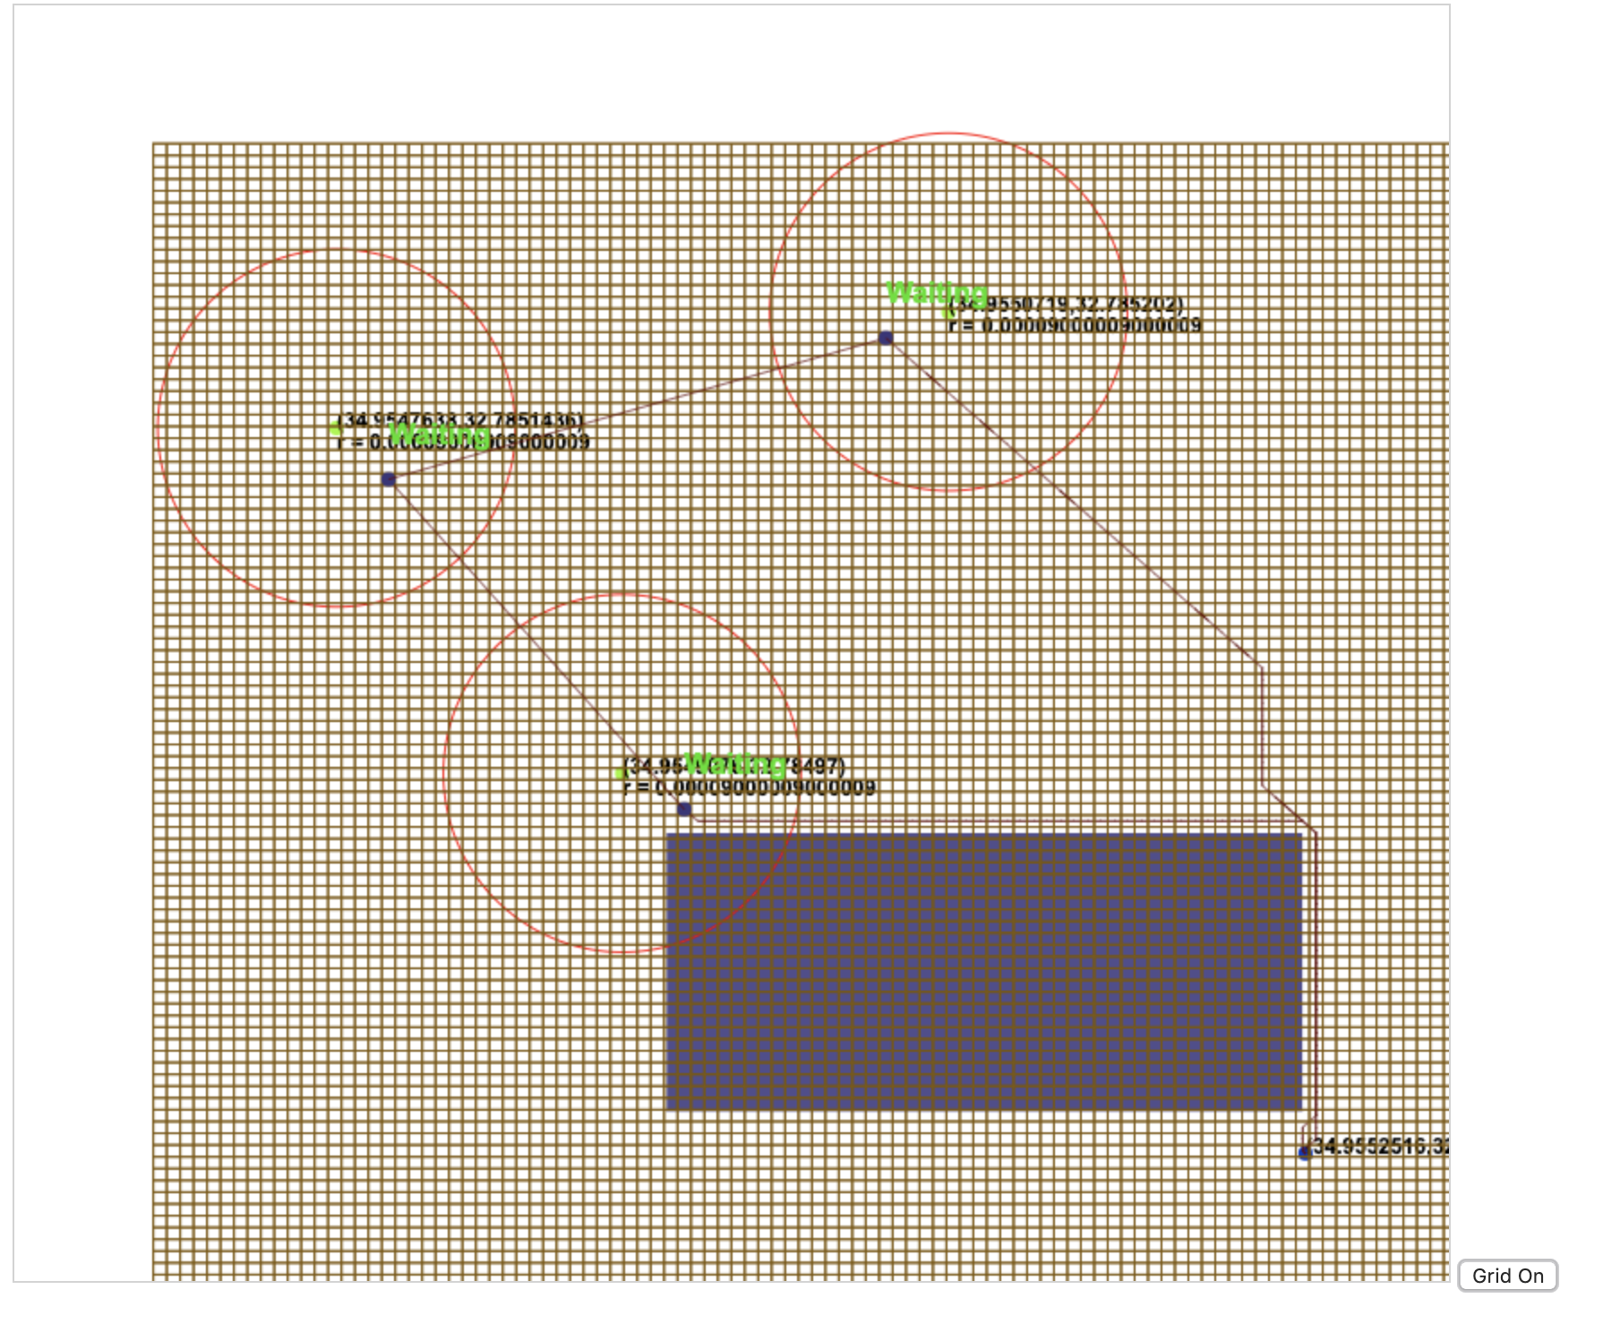
Algorithm Flow – Dynamic Obstacle Traveling Salesman (1)
Graph nodes – squares in grid
Each non corner grid has 8 neighbors
Dijkstra is run over the grid

Slide 17
Algorithm Flow – Dynamic Obstacle Traveling Salesman (2)
Set up groups (add to list)
(get point) start at start_point
For each group find a representative point inside group polygon
Find optimal point inside group shape
Use Dijkstra on point to calc all paths and distances to those points
For each group repeat previous stages recursively after removing this group from the list
Select the best route found

Slide 18
Solution – From Sensors to Server
Path Planning
Mission Planner
Drone
LoRaWAN Server
LoRaWAN GW
LoRaWAN Sensors

Slide 19
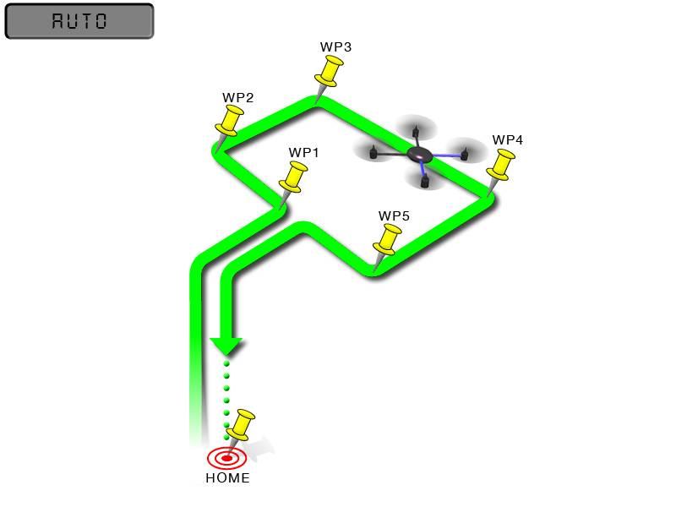
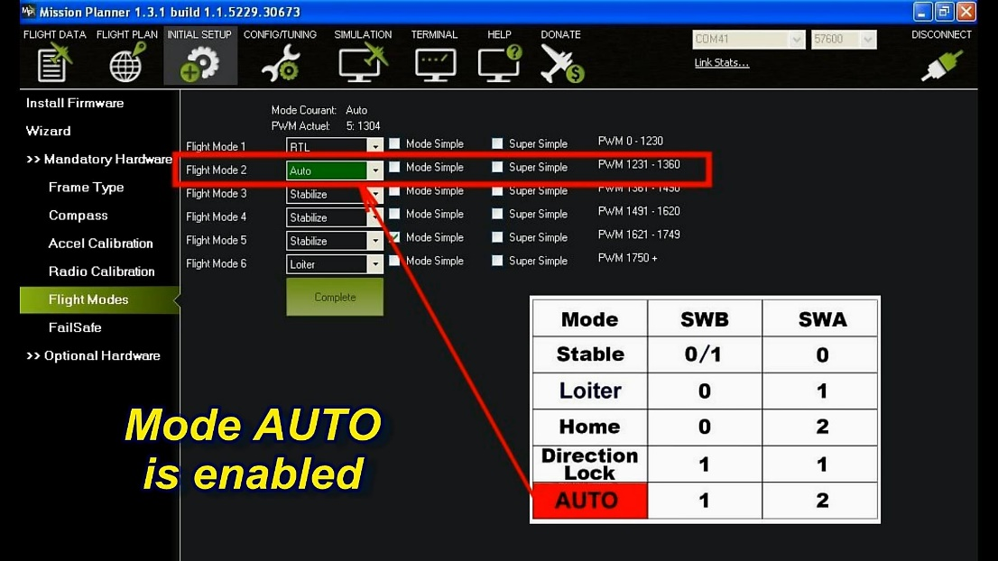
Solution – Drone
We use drone in auto mode which means that we don’t need to control the drone during the flight. It follows a pre-programmed mission script stored in the autopilot.
In our case drone will fly over all sensors according to path which was made by our planning algorithm, and will return back to starting point. The touch down also will be automatic.
GPS

Slide 20
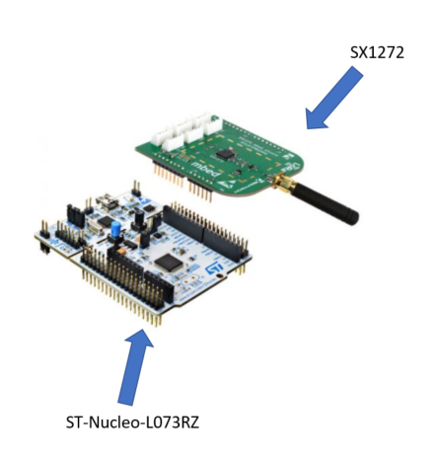
Solution – Sensors
Two connected HW components:
STM Nucleo L073RZ:
192KB flash
20KB SRAM
Semtech SX1272:
LoRa RF transceiver.

Slide 21
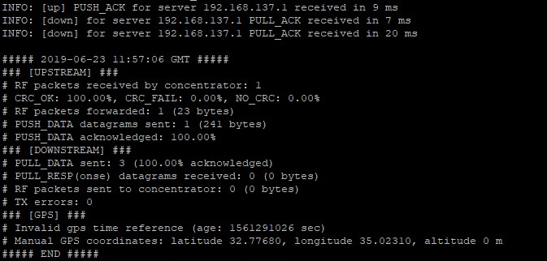
Solution – SW and HW Gateways
We used
Raspberry Pi with Semtech sx1272 LoRa transceiver for the HW Multichannel Gateway
iC880a-based SW GW for the SW Gateway

Slide 22

Solution – From Sensors to Gateway
We need to send the data from the sensors to the gateway mid flight.
Current SW allows to send data from sensor to gateway only when the server is on.
Server is offline (out of range) and SW Gateway cannot forward the packets directly.
We updated packet forwarding mechanism of SW Gateway to enable storing the packets offline.
+
Gateway
Drone
LoRa Frequency 868.1 MHZ
LoRaWAN Sensor

Slide 23

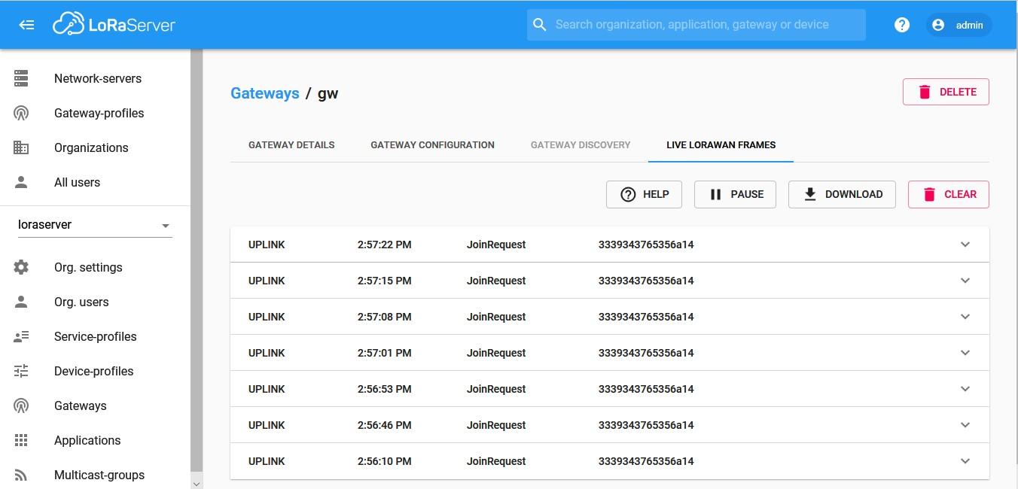
Solution – From Gateway to Server
We used open source
SW Gateway is constantly trying to reach server.
Once it connects to the server, it forwards all unsent packets received during the flight.

Slide 24
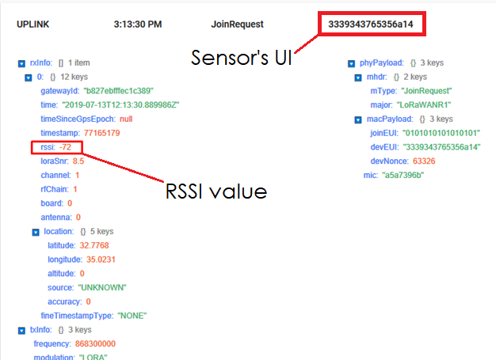
Solution – Analysis and signal radii update after a flight (1)
First flight assumes signal radius of 0. Each successor flight will update it based on analysis.
Able to detect both UI and RSSI after getting the data from the server
Able to detect packet sender by UI
Signal radii can be updated using packet RSSI+UI
Accurate radius will result in optimal path while still being able to collect all the data.

Slide 25
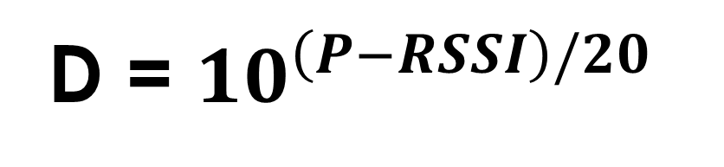
Solution – Analysis and signal radii update after a flight (2)
D – Distance in meters from the sensor.
P – TxPower. A variable received by the beacons in the package.
Calculate D for each sensor after the flight using the formula
Update input files based on the newly calculated D
D = ${10}^{\left(P−RSSI\right)/20}$

Slide 26
Summary - Learning
We learned about LoRaWAN protocol and set up a simulation framework
We learned LoRaWAN GW SW framework in depth
We read scientific papers to learn about ways to make path planning with obstacle avoidance
We mastered our knowledge in multiple programming languages (C++, Pythong, JS)

Slide 27
Summary - Implementing
We made changes to the open source LoRa GW
Save packets locally
Unload to server
We contributed to ic880a-gateway, an open source Github project!
We implemented a smart Path Planning algorithm
We integrated all the pieces together and made a successful flight experiment

Slide 28
What’s next?
RSSI parsing
Algorithm improvements:
Maybe there is a way to find a more optimal path than the algorithm we used?
3d Path Planning
Dynamic Path Planning
Distributed algorithm for multiple drones
Integration of classes A & B

Slide 29

Questions?

